Slide 1
One hidden layer
Neural Network
Why do you
need non-linear
activation functions?
Notes:
For NN to compute interesting functions we need non linear activatyion functions.

Slide 2



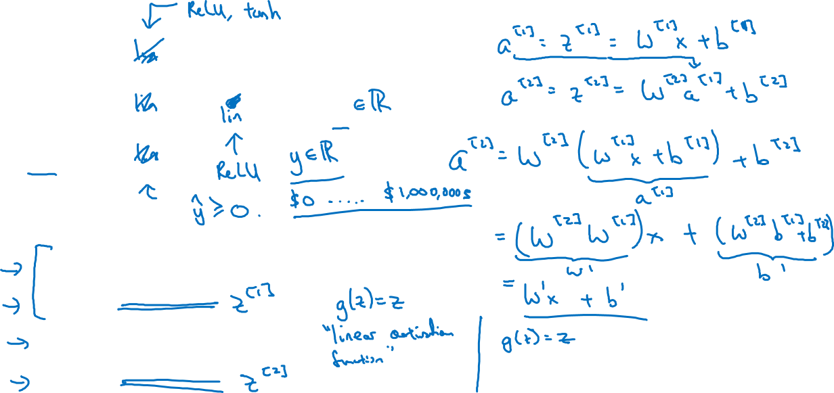





Activation function
$$x_{1}$$
$$x_{2}$$
$$\hat{y}$$
$$x_{3}$$
Given x:
$$z^{\left[1\right]}=W^{\left[1\right]}x+b^{\left[1\right]}$$
$$a^{\left[1\right]}=g^{[1]}(z^{\left[1\right]})$$
$$z^{\left[2\right]}=W^{\left[2\right]}a^{\left[1\right]}+b^{\left[2\right]}$$
$$a^{\left[2\right]}=g^{[2]}(z^{\left[2\right]})$$
Notes:
if we don’t apply nonlinear functions, it will be like that we are computing only linear relationships between x & y. This is not always the case.
This will be like applying linear functions again & again & this will only learn linear relationships
We call these linear activation functions as identity functions, & if we use these functions it does not matter how many hidden layers we have.
Even if we use sigmoid function at the end & linear functions in hidden layers even than it will be just like logistic regression.
Only in case if we are doing machine learning on regression problems we cam use linear activation functions such as housing prices to get us real number outputs. This is the case when we are using linear activation function in the output function not in the hidden layers. Even in these cases, in hidden layers we use non linear activation functions.
Even in case of housing prices which are not negative,

